Slide 1

19AIE111 DATA STRUCTURES AND ALGORITHMS
END SEM PROJECT
PRESENTATION
BATCH 15
SVS Dhanush - CB.EN.U4AIE20068
Swarnamuhi K - CB.EN.U4AIE20069
A Swetha Tirumalai - CB.EN.U4AIE20070
Tarun S - CB.EN.U4AIE20071

Slide 2
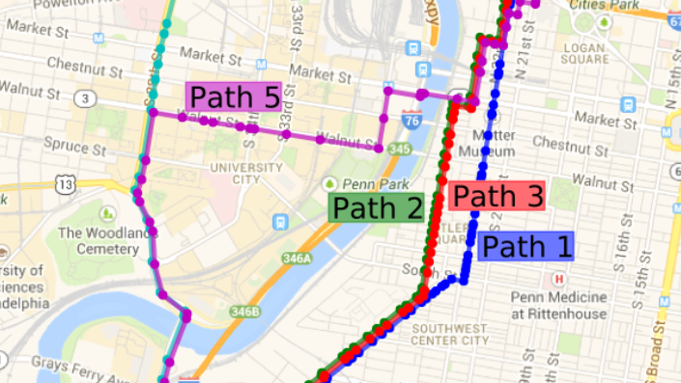
FINDING THE SHORTEST PATH

Slide 3

SHORTEST PATH ALGORITHM
The shortest path algorithm is given a weighted graph or diagram G = (V,E,W) and two specified vertices v and w; the algorithm finds a shortest path from v to w.
The distance from a vertex v to a vertex w (denoted d(v, w)) is the weight of a shortest path from v to w.
Shortest path algorithms have various uses, most notable being Route planning software such as Google Maps, etc.

Slide 4

WHY DIFFERENT ALGORITHMS?
Most people are aware of the shortest path problem, but their familiarity with it begins and ends with considering the shortest path between two points, A and B.
However, for computer scientists this problem takes a different turn, as different algorithms may be needed to solve the different problems.

Slide 5
SHORTEST PATH ALGORITHMs
Dijkstra’s Algorithm
Bellman-Ford Algorithm
Floyd-Warshall Algorithm
Johnson’s Algorithm

Slide 6

Shortest path algorithms operate on a graph, which is made up of vertices and edges that connect them. A graph may be directed, undirected, weighted, and more. It’s these distinctions that determine which algorithm will work better than another for certain graph types.
In our case, we will use Dijkstra's shortest path algorithm to find shortest paths.

Slide 7
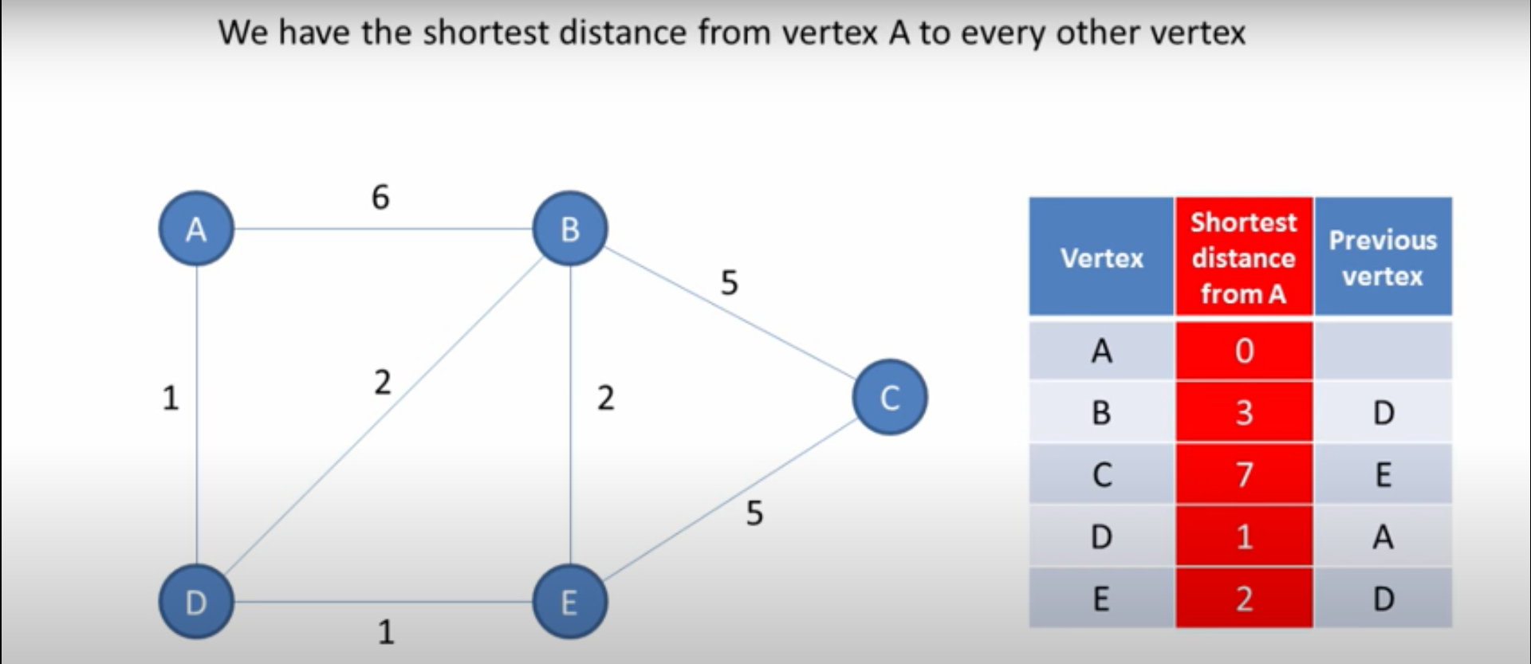

Slide 8
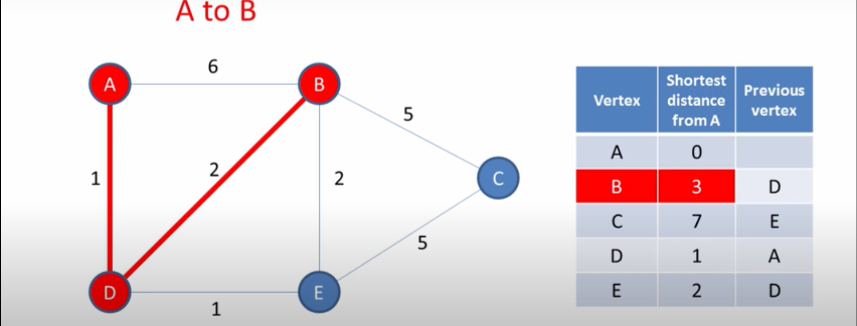

Slide 9
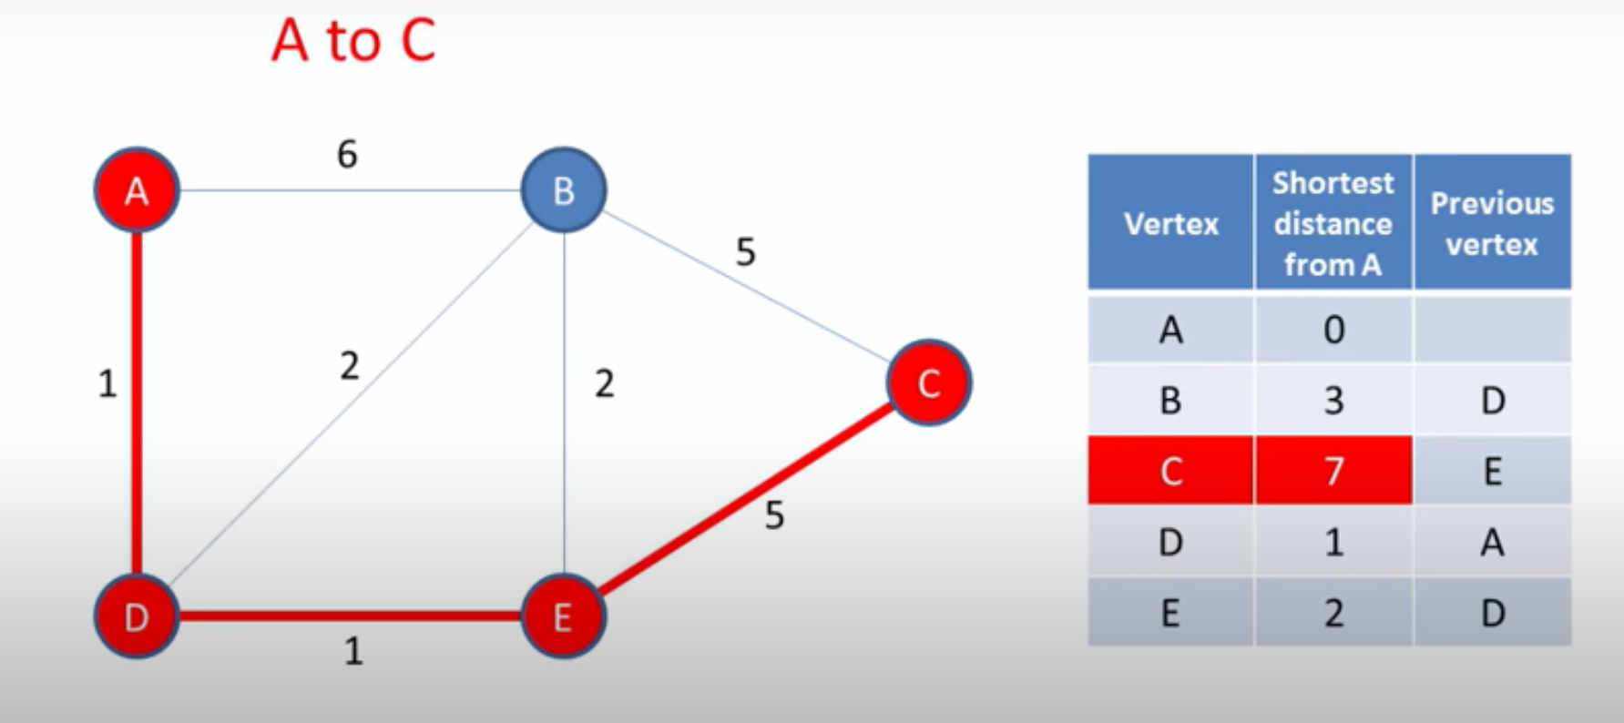

Slide 10
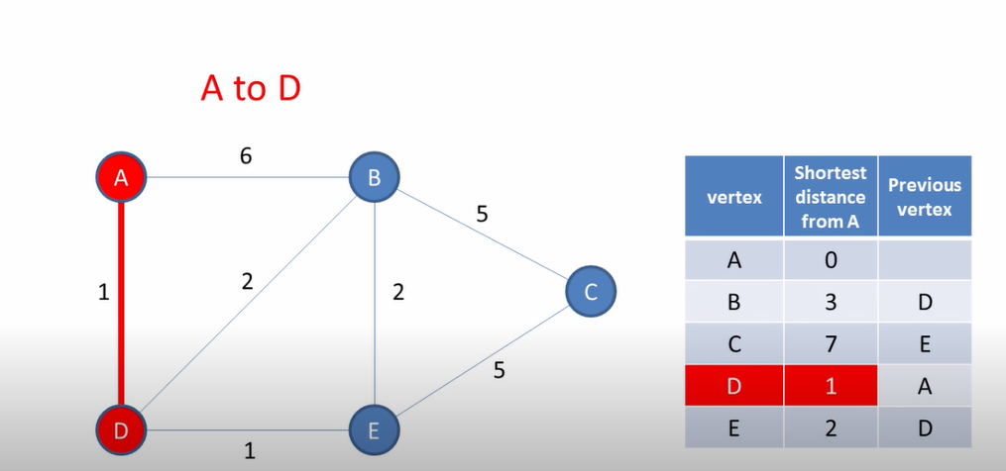

Slide 11
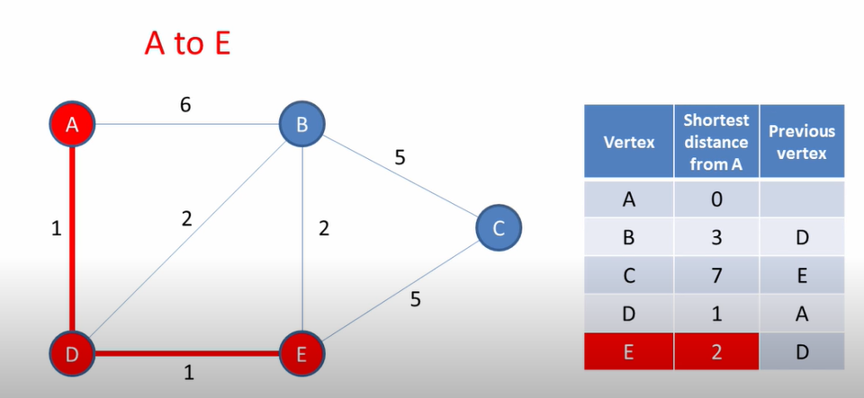

Slide 12
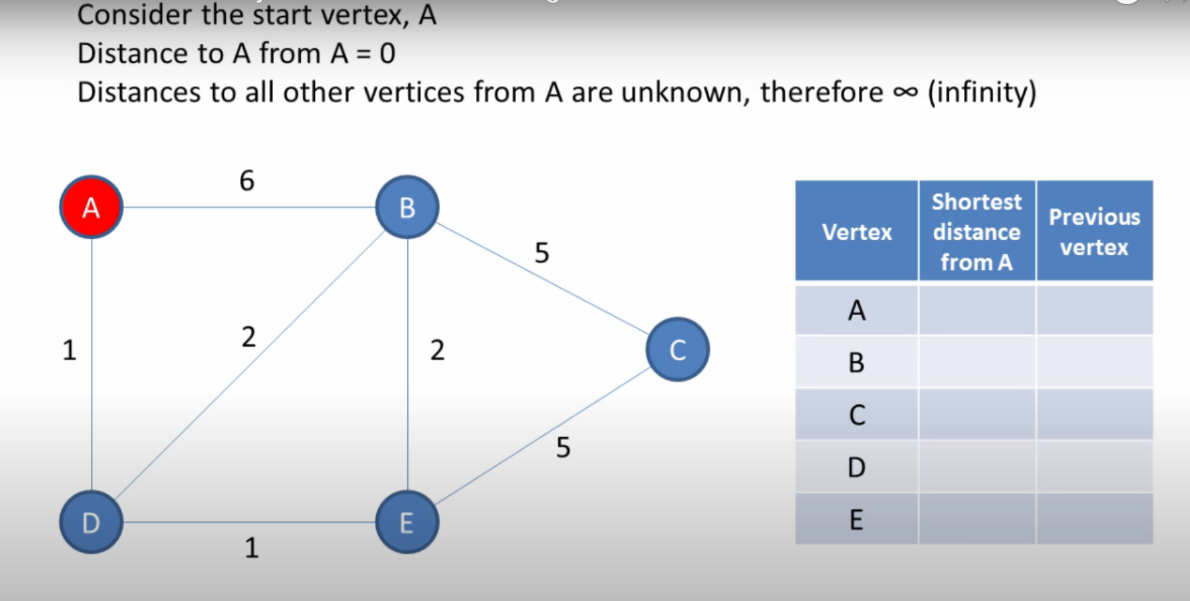

Slide 13
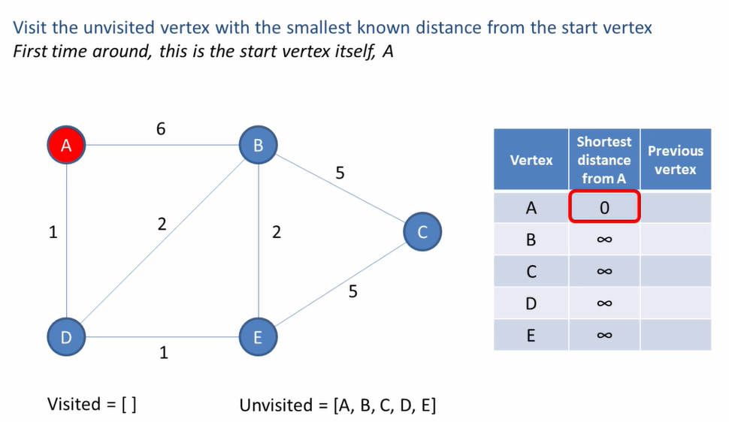

Slide 14
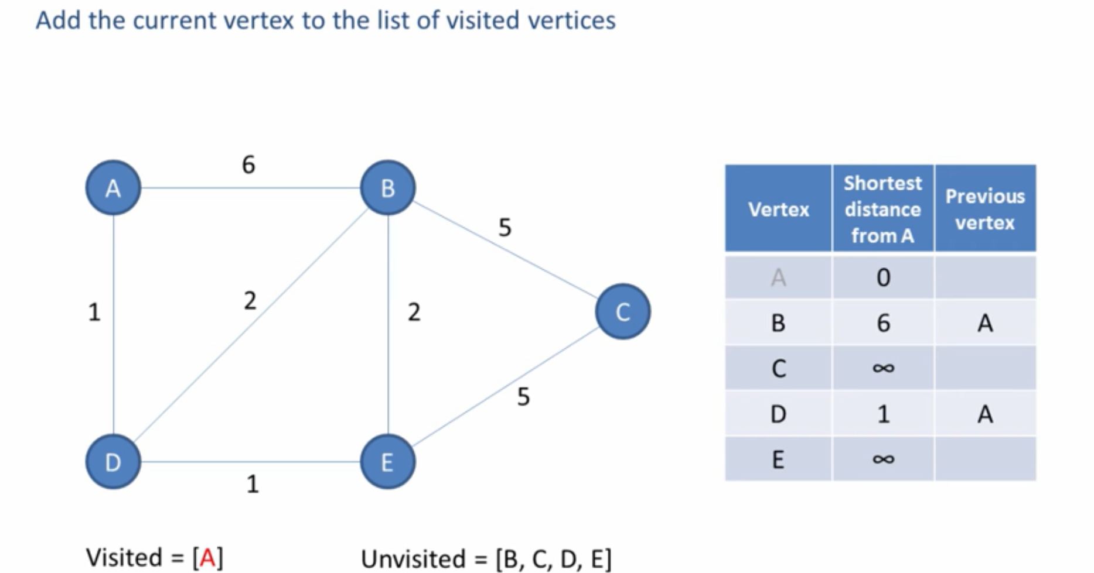

Slide 15
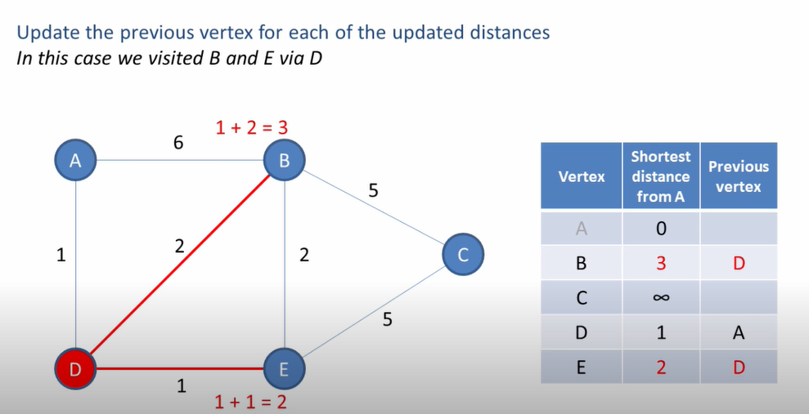

Slide 16
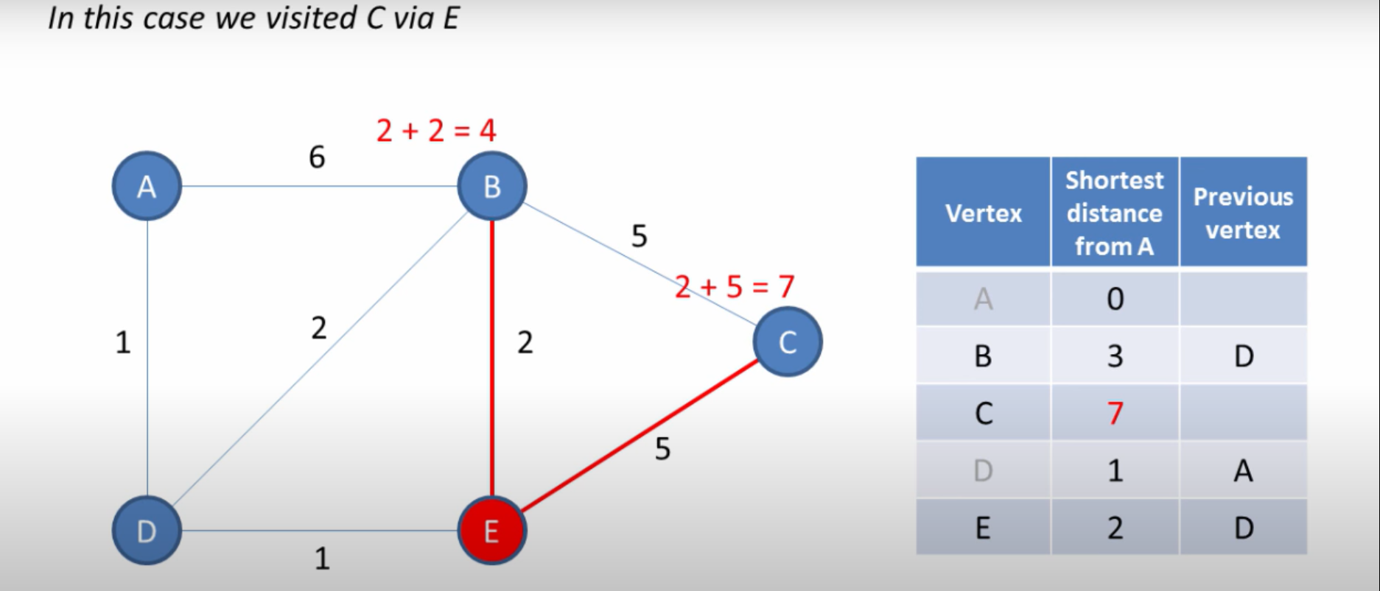

Slide 17
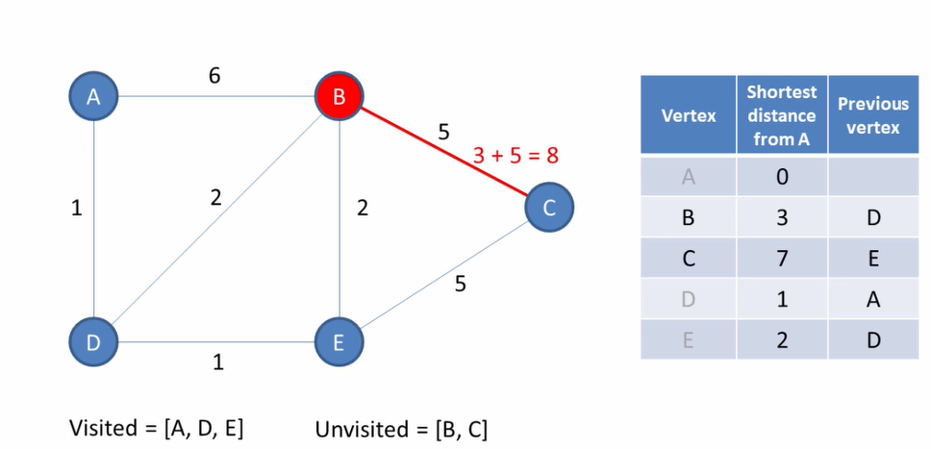

Slide 18
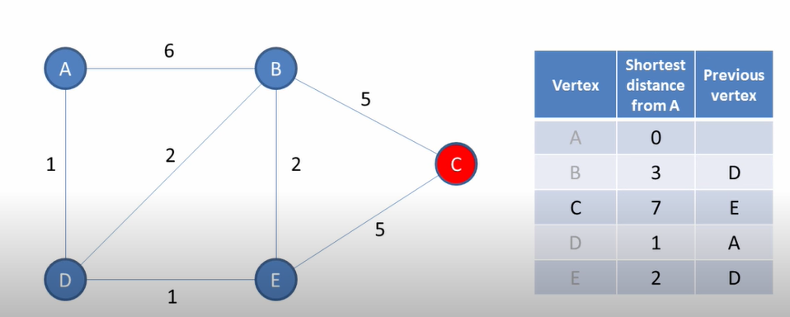

Slide 19
Dijkstra's Algorithm
INITIALIZATION:
Let distance of start vertex from start vertex = 0
Let distance of all other vertices from start = ∞ (infinity)
REPEATING STEPS:
Visit the unvisited vertex with the smallest known distance from the start vertex
For the current vertex, examine its unvisited neighbours
If the calculated distance of a vertex is less than the known distance, update the shortest distance
Update the previous vertex for each of the updated distances
Add the current vertex to the list of visited vertices
Repeat these steps until all vertices visited.
For the current vertex, calculate distance of each neighbour from start vertex

Slide 20

IMPLEMENTATION AND CODE

Slide 21
THANK YOU

